Slide 1

Process Diagram & Documentation Forms
Robert J. Esposito III, Christopher Dinis, Marc Castillo, & Rene Guevara
Professor Zesk
Configuration Management/ENGN 4010
April 4, 2018

Slide 2
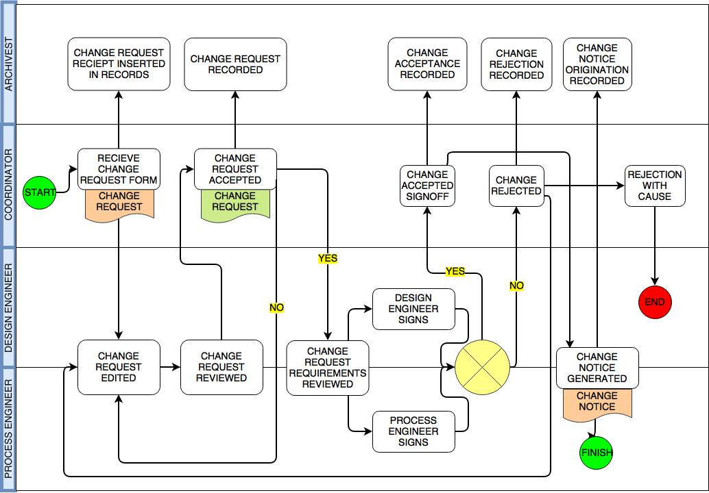

Slide 3
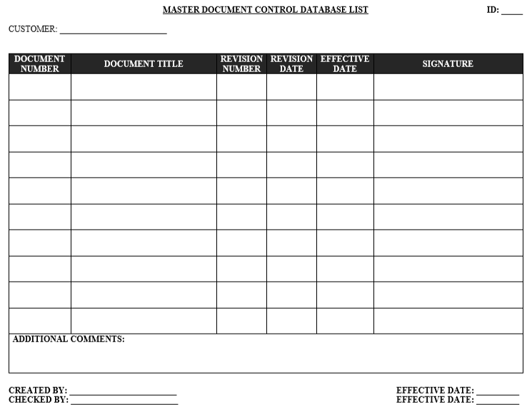

Slide 4
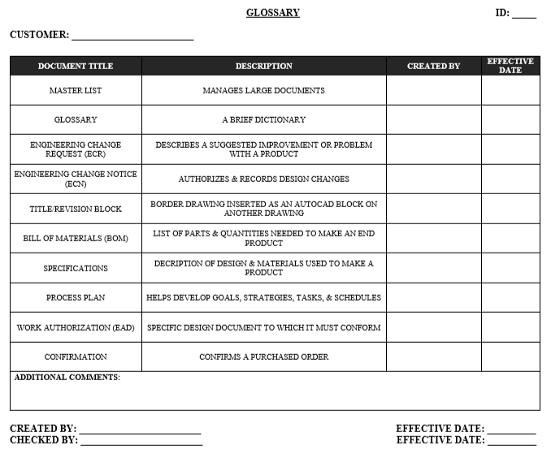

Slide 5
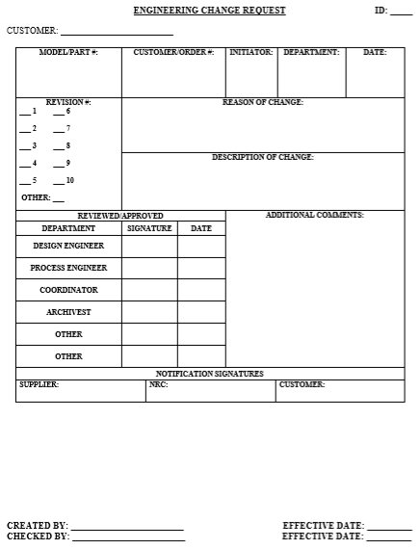
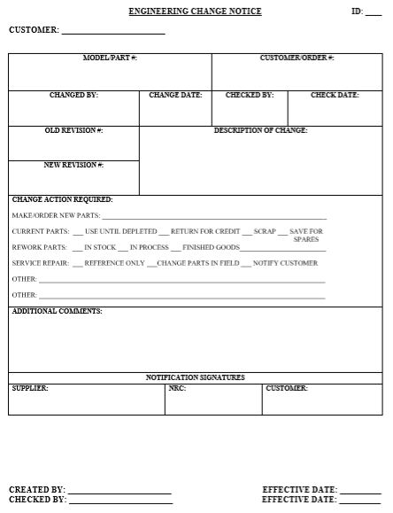

Slide 6
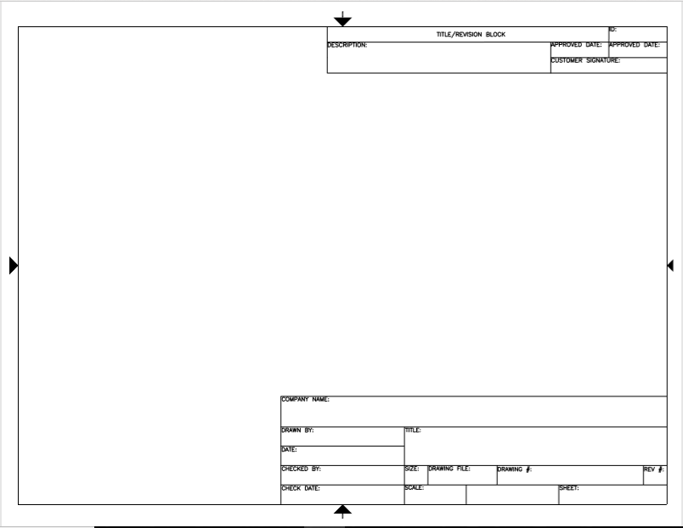

Slide 7
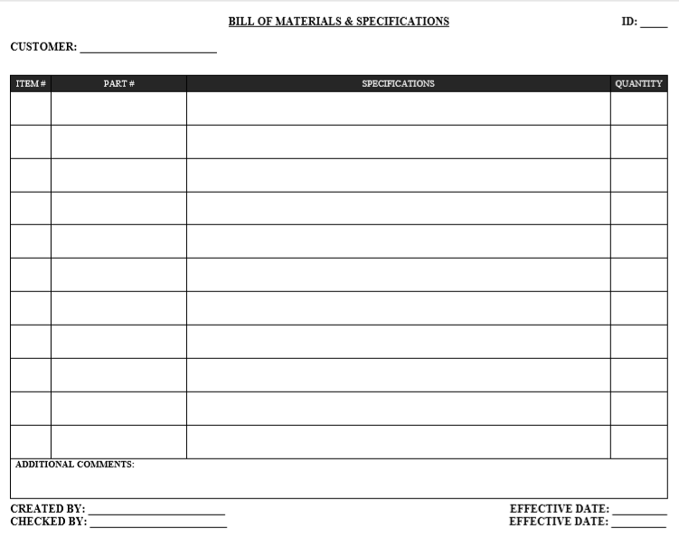

Slide 8
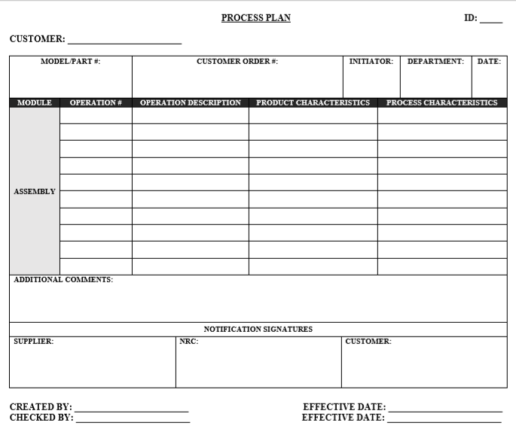

Slide 9
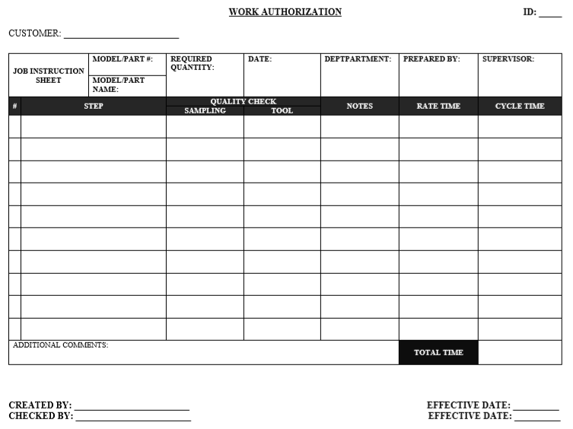

Slide 10
